Slide 1
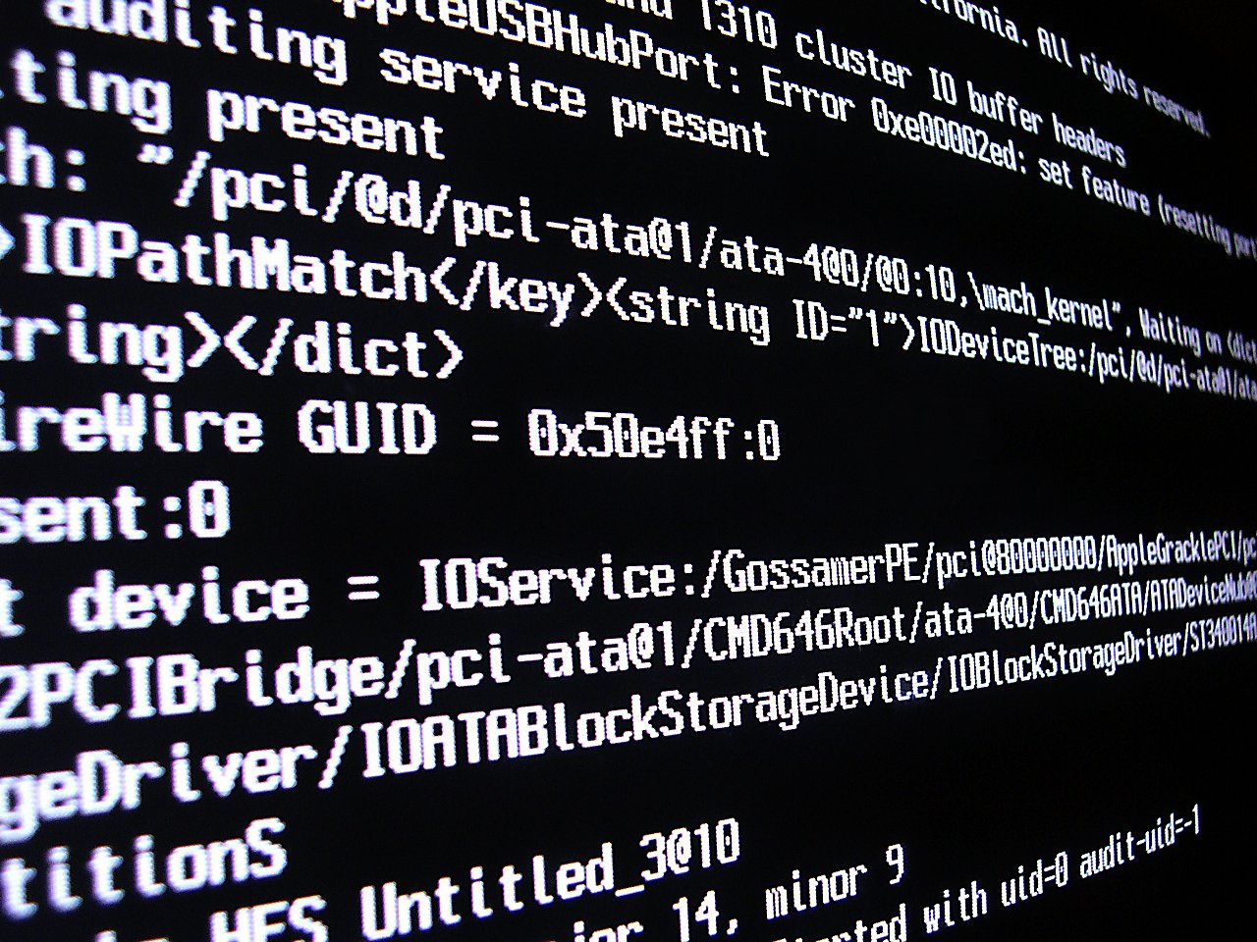
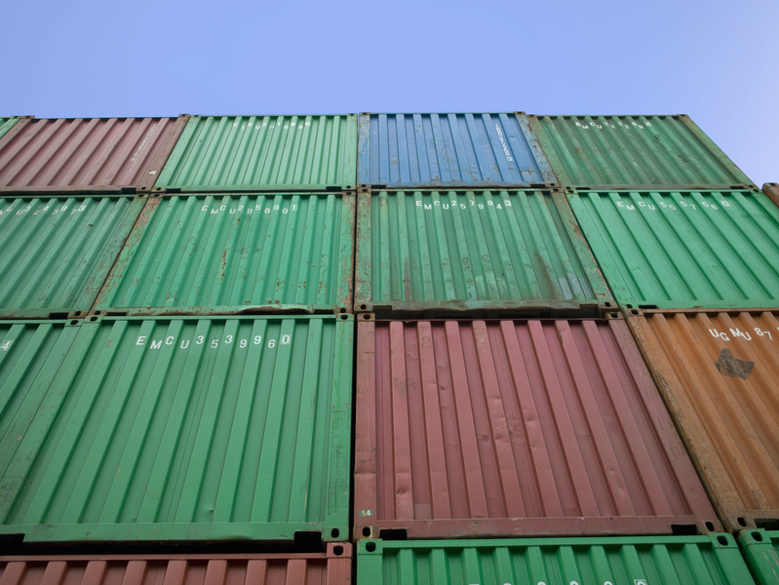

Modernizing BFIN: Implementing IaC and Containers
In this presentation, we will discuss:
What is Infrastructure as Code and Containers
How this would apply and benefit BFIN
Image credit: https://www.freeimages.com/
Image credit: https://www.freeimages.com/

Slide 2
What is Infrastructure as Code?
(old)
(new)
Server
Server
App
The idea of automating deployment of resources for any given Infrastructure or internal system
Standardized and set configurations for servers, systems and resources to host applications and software
Allow for easy scalability and rapid deployment of resources within a given developmental environment
Enable easier sharing and maintenance
Configuration
App
App
App
Configuration
App
App
App
Configuration
App

Slide 3
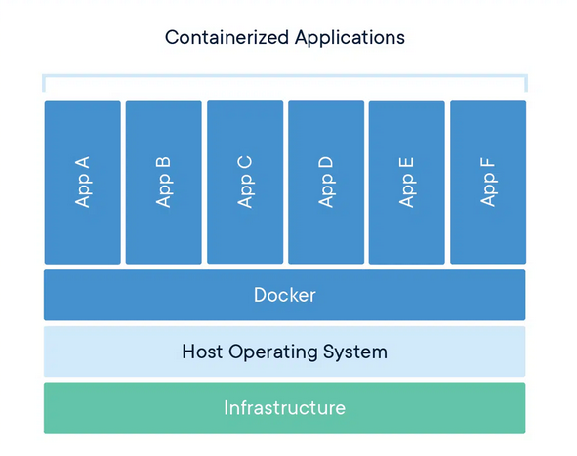
What are Containers?
Splitting of an application or service into a smaller component, referred to as a “microservice”
Hosted inside of a parent application that lives in the Operating System rather than requiring a separate VM/instance
Packaged to contain the entirety of an application for easy sharing and deployment
Image credit https://www.docker.com/resources/what-container/

Slide 4
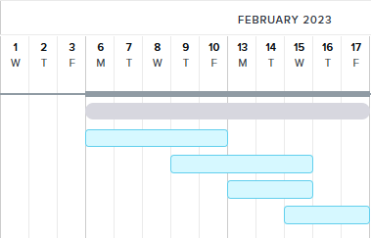
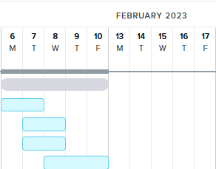
Applying this to BFIN
Image credit (personal project): https://app.teamgantt.com
Current timeline requires days for manual deployments of configurations, changes, and to verify that updates and new releases work within the current environment
This can be counter-productive and will not scale well with onboarding newer and larger clients
Proposed timelines within the new framework allow for deployment of automated and controlled infrastructure
Rollout of new updates and testing will be streamlined and can be easily re-deployed if any issues arise, resulting in a lower turn-around time

Slide 5

Reasoning & Conclusion
Allow for easier scalability and streamlined workflow with developing new products and fixes for current solutions
Shift more of the focus towards the clients and current relationships, rather than engaging in long meetings to sustain old applications with limited documentation
Increase internal efficiency to provide the industry-leading solutions BFIN has been renowned for
Image credit: https://www.freeimages.com/

Slide 6
Questions?
Reach out to me on Slack! @abrig
andrew.bright@bfinsolutions.com

Slide 7
Sources
Events & Presentations. Donnelley Financial Solutions - Events & Presentations. (n.d.). Retrieved January 31, 2023, from https://investor.dfinsolutions.com/events-and-presentations/default.aspx
What is a container? Docker. (2022, December 9). Retrieved January 31, 2023, from https://www.docker.com/resources/what-container/
Images sourced from https://www.freeimages.com/
Gantt chart generated at https://app.teamgantt.com

